Slide 1
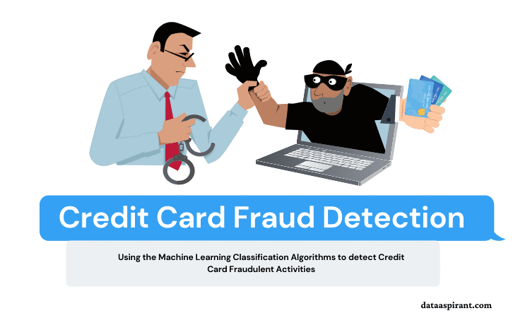

Slide 2
Credit Card Fraud Prediction
Team Members

Slide 3
Executive Summary
Businesses are constantly drifting toward joining their administrations to the online environment as the extensive use of the Internet increases. The development of internet based. e-Commerce sites on the other hand has led to the situation where most individuals and companies rely upon online administrations for all their monetary transactions today. There has been an exponential increase in the use of internet banking together with an increase in the variety of online transactions, as a result of which there has been an exponential increase in credit card fraud as well.

Slide 4
Executive Summary
There are several mechanisms for protecting credit card transactions, including methods of encrypting and tokenizing credit card data. Even though such approaches are effective in the majority of cases, they do not provide full protection against credit card fraud in all cases. Artificial Intelligence (AI) is a field that examines the ways in which computers can learn based on their previous experiences with data (in other words to become smarter and better at predicting events without being explicitly programmed to do so).

Slide 5
Executive Summary
Researchers are currently pursuing the most optimal approach to detecting such frauds using data science. It is important to know that credit cards contain sensitive data, and they can be used to commit fraud affecting not only the holder of the card, but also banks, governments, and all types of financial sectors which leads to high losses on the financial front.
Various Machine Learning algorithms are available that can be used for detecting fraud transactions so as to overcome such losses and to prevent such a scenario from occurring in the future. The objective of this study is to determine what algorithm model is most efficient among all the ones studied and to come up with an optimal solution among all of them.

Slide 6
Project Background
Since the world is moving towards a cashless society, there is going to be a consistent increase in transactions that are done online. There is no requirement for fraudsters to physically be present at the crime scene to commit fraud. There are many ways to hide their identities so that they can carry out these diabolical acts from the comfort of their own homes. There are a number of identity obscuring techniques which include the use of VPNs, to route traffic through the Tor network, etc. These techniques are difficult to trace back, and are considered as anonymous as possible.

Slide 7
Project Background
Fraudsters, after stealing card details, are either able to use the cards for their own purchases or sell them on to other people, as is currently happening in India, where around 70 million credit and debit card details are being sold on the dark web (Tanouz et al., 2021). An incident in the UK involving credit card fraud that was one of the most serious in recent memory resulted in a total loss of GBP 17 million that was related to such an incident.

Slide 8
Project Background
As a consequence, it is very challenging to detect fraud in an environment which is flooded with thousands of legitimate transactions, particularly when the number of fraudulent transactions is significantly smaller than that of legitimate transactions. Fraud detection technologies have been deployed in several financial industries in order to fight fraud more effectively, including predictive analytics, data mining, and modelling algorithms that employ clustering.

Slide 9
Motivation
With the rapid growth of electronic payments, there has also been an increase in electronic fraud. Dealing with fraud in the banking and commerce industries has been very challenging. Fraudsters have become adept at finding loopholes.
It has therefore become increasingly important for companies to manage vulnerability effectively and close security loopholes by detecting fraudulent activity through machine learning and predictive analytics. VynZ Research identified fraud detection and prevention as a significantly large market, anticipated to reach a value of USD 85.3 billion over the next five years, growing at a compound annual growth rate of 17.8%.

Slide 10
Problem Statement
The performance of this fraud detection system is complicated by a few issues that are difficult to resolve for researchers. Among one of the most challenging issues is the absence of high-quality literature in the field that provides test results and authentic data. Frequently, the reason for this is that the sensitive financial information associated with the fraud needs to be used in a confidential manner in order to protect the customer's privacy and security.

Slide 11
Research Objectives
The goal of the proposed method is to detect fraudulent credit card purchases using supervised machine learning algorithms. With the purpose of detecting fraud transactions, we came up with a technique whereby we extract the features of a dataset, using the extracted features to train the models for the sole purpose of detecting fraud transactions. The following objectives will be met by the proposed solution:
To determine the level of fraud activity associated with credit cards with high efficiency and accuracy.
To train a high-performance model on a given dataset using both label and feature information.
To determine whether a transaction is fraud or not using the trained model.

Slide 12
Proposed System
The data flow into a system model is defined as the system architecture. During the pre-processing phase, steps are taken to convert the raw data into useful information. On the basis of the characteristics extracted from the data, an algorithm is then selected that is used to classify a specific transaction as legal or illegal based on the features it is derived from.

Slide 13
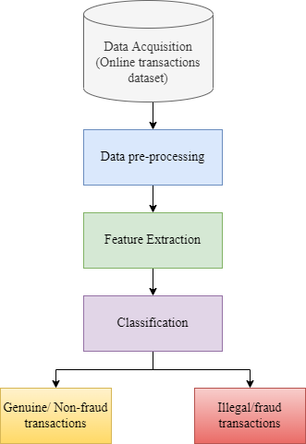
The data flow diagram of proposed system.

Slide 14
Data Preparation Activities
A dataset which was used in this study was the Credit Card Fraud Detection dataset which is available on Kaggle (Credit Card Fraud Detection | Kaggle, n.d.-a), and that could be downloaded from there.
This dataset consists of data from credit card transactions made by European cardholders for the month of September 2013. Within two days, they have 492 fraudulent transactions out of 284,807 transactions within this dataset. A substantial portion of the dataset's transactions fall into the positive class (frauds), accounting for 0.172% of all transactions.

Slide 15
Data Preparation Activities
There are only numerical variables that are the results of a PCA transformation that are included in this analysis. Among the features V1, V2, …., V28, we can see they are the principal components resulting from PCA, however, 'Time' and 'Amount' have not been transformed by PCA.
A feature called "Time" represents the number of seconds that passed between each transaction and the first transaction found in the dataset.
With 'Amount', one can show the amount a transaction has, this feature can even be used for instance-dependant and cost-sensitive learning.
In the 'Class' feature, in the case of fraud, it takes the value of 1 while in the case of non-fraud, it takes the value of 0.

Slide 16
S. No. | Feature | Description
1. | Time | The time in seconds between the current and the first transaction.
2. | Amount | Amount of the transaction
3. | Class | 0 - Class label represents not fraud 1 - Class label represents fraud
Description of features of dataset.

Slide 17
Data Pre-Processing
Pre-processing is not necessary for every dataset if certain criteria are met. As part of these criteria there is the requirement to determine if there are any missing values that might cause the prediction values to be altered.
Based on our analysis of the data, we can see that the dataset contains 284,807 values for each feature, which means that no value is missing from any of these features.

Slide 18
Data Pre-Processing
It has been shown that correlation matrix is an effective technique for assisting us in determining whether any particular part of the report could be removed in order to ensure the accuracy of the proposed system.
Due to the fact that the correlation matrix has shown that all features are associated with the 'Class' feature irrespective of whether there is a strong correlation or not, on the basis of this, one may conclude that it is not necessary to pull out any particular attribute when analyzing the correlation matrix; as a result, there is no requirement to perform any pre-processing.

Slide 19
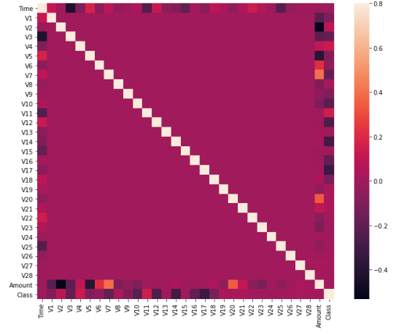
Attribute correlation matrix (the X and Y axis show the different attributes within the dataset).

Slide 20
Handling Imbalanced Data
There was a great deal of imbalance in the credit card data. The original data set contained 99.83% of the real-world transactions as non-fraudulent, compared to 0.17% that were fraudulent. Using the original data set in case of a fraud detection algorithm would not be a wise decision for a very simple reason.
For the creation of our balanced training data set, we will use SMOTE algorithm. We will compare the results of our chosen machine learning algorithm before and after using SMOTE algorithm.

Slide 21
Handling Imbalanced Data
The SMOTE algorithm works by picking examples near one another in the feature space, setting up a line to connect them in the feature space, and creating a new sample in the feature space at the point where that line meets the previous sample.
In particular, a randomly selected example from a class of minority members is first chosen. After that, k of the closest neighbors of that example are found (normally, k is 5). There is a choice of a neighbor randomly selected and a synthetic example is produced by selecting a random point in the feature space between the two examples.

Slide 22
Data Analytics
The start of the process involves retrieving data, in this case data was downloaded from Kaggle’s credit card fraud detection dataset.
Data samples are then divided up between training and testing. 80% train and 20% test file.
After taking the data balance algorithm, SMOTE, which applies a balance approach to the training dataset.
A variety of machine learning algorithms are then trained on the dataset.
Finally, evaluation measures are used to evaluate the machine learning algorithms.

Slide 23
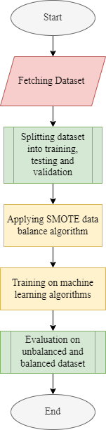
Steps of proposed system.

Slide 24
Techniques Used
The techniques we selected for the proposed approach are Random Forest Xboost and LightGBM.
After experiencing a multitude of Classification Algorithms, we had obtained the knowledge that the best algorithms in terms of efficiency and accuracy in classification algorithms these days would be Random Forest and XG Boost.
So we decided to utilize them both together for and also LightGBM for designing our model and compare their results.

Slide 25
Working of Random Forest
Performing the random forest algorithm involves a number of basic steps:
Select N records at random from the dataset.
From this selection, create a decision tree depicting the probability of this outcome.
We can choose how many trees you want to include in your algorithm by repeating steps.
Each tree in the forest predicts what category the new record belongs to.
It is then decided which category will be assigned the new record, based upon the votes of the majority.

Slide 26
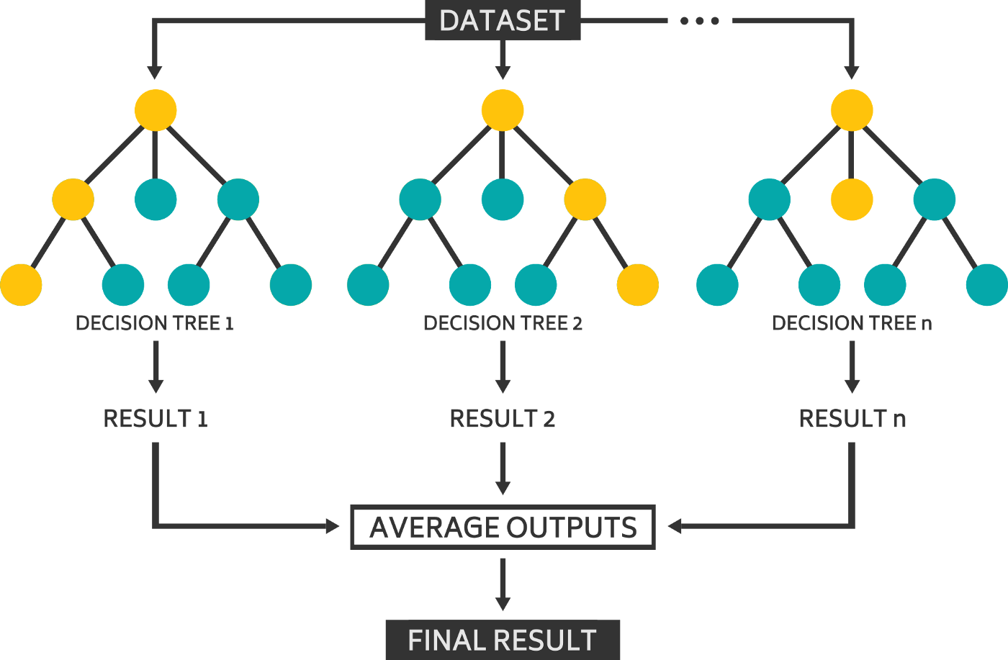
Workflow of Random Forest algorithm.

Slide 27
Working of XGBoost
The weak learners in gradient boosting are regression trees, where each of the leaves of each regression tree is a continuous score, mapped to a point in the input data.
A regularized (L1 and L2) objective function minimized by XGBoost is a combination of a convex loss function (based on the difference between the predicted and actual output, and vice versa) as well as a penalty term for the complexity of the model (the regression tree functions, etc.).
Iteratively, the tree prediction is made by adding new trees that predict the errors or residuals of the previous trees, and these predictions are then merged together to generate the final prediction.
In this way, gradient boosting minimizes any loss associated with adding a new model by using a technique known as gradient descent.

Slide 28
Working of LightGBM
With LightGBM, trees are split level-wise rather than the other boosting algorithms which grow trees level-wise.
LightGBM grows only the leaves that produce the biggest delta loss. The leaf-wise algorithm has the advantage of having a lower loss than level-wise algorithm since the leaf is fixed.

Slide 29
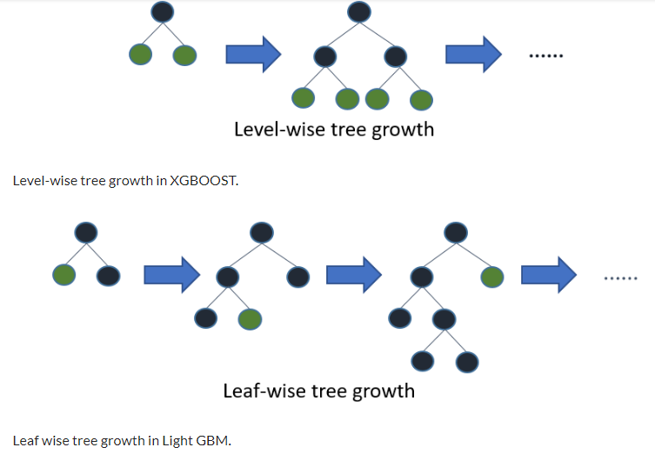
Workflow of XGBoost and LightGBM algorithms.

Slide 30
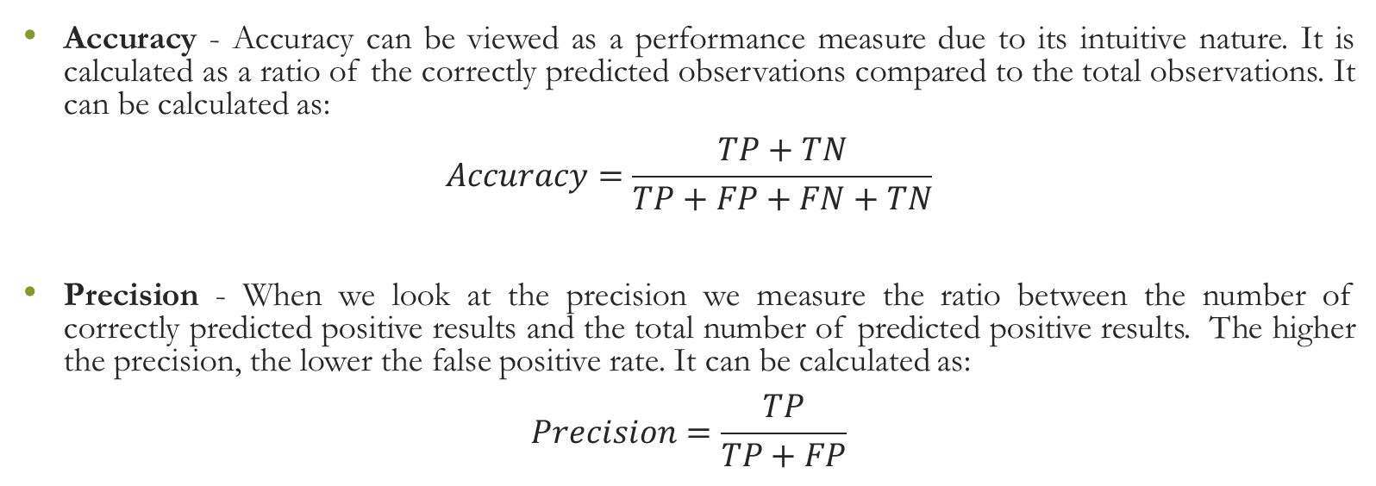
Evaluation Parameters
Accuracy - Accuracy can be viewed as a performance measure due to its intuitive nature. It is calculated as a ratio of the correctly predicted observations compared to the total observations. It can be calculated as:
$$Accuracy=\frac{TP+TN}{TP+FP+FN+TN}$$
Precision - When we look at the precision we measure the ratio between the number of correctly predicted positive results and the total number of predicted positive results. The higher the precision, the lower the false positive rate. It can be calculated as:
$$Precision=\frac{TP}{TP+FP}$$

Slide 31
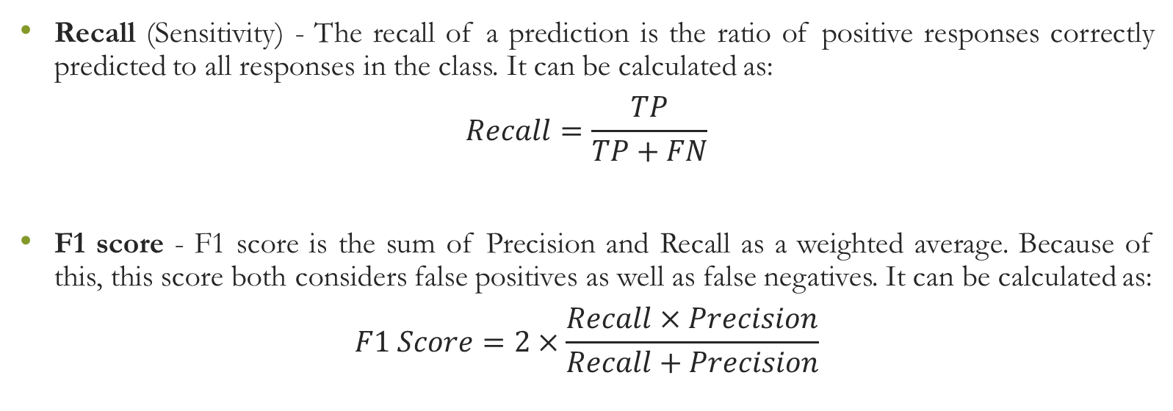
Evaluation Parameters
Recall (Sensitivity) - The recall of a prediction is the ratio of positive responses correctly predicted to all responses in the class. It can be calculated as:
$$Recall=\frac{TP}{TP+FN}$$
F1 score - F1 score is the sum of Precision and Recall as a weighted average. Because of this, this score both considers false positives as well as false negatives. It can be calculated as:
$$F1 Score=2×\frac{Recall×Precision}{Recall+Precision}$$

Slide 32
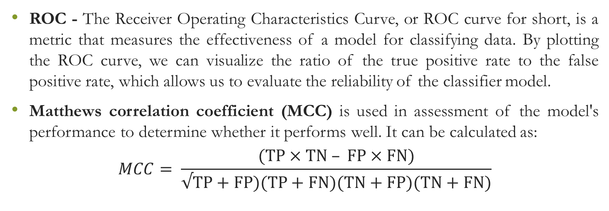
Evaluation Parameters
ROC - The Receiver Operating Characteristics Curve, or ROC curve for short, is a metric that measures the effectiveness of a model for classifying data. By plotting the ROC curve, we can visualize the ratio of the true positive rate to the false positive rate, which allows us to evaluate the reliability of the classifier model.
Matthews correlation coefficient (MCC) is used in assessment of the model's performance to determine whether it performs well. It can be calculated as:
$$MCC= \frac{(TP×TN – FP×FN)}{√TP+FP)(TP+FN)(TN+FP)(TN+FN)}$$

Slide 33
Steps of Methodology
Read Dataset
Plotting the histogram of each feature
Determine number of fraud cases in dataset
Split the data into training and testing
Applying machine learning algorithm on unbalanced dataset
Applying machine learning algorithms on balance dataset
Compare results on basis of evaluation parameters

Slide 34
Results on unbalanced dataset
Algorithm | Accuracy | Recall | Precision | F1 Score | ROC | MCC
Random Forest | 0.99959 | 0.83505 | 0.92045 | 0.87567 | 0.91746 | 0.87651
XGBoost | 0.99961 | 0.83505 | 0.93103 | 0.88043 | 0.91747 | 0.88154
LightGBM | 0.99590 | 0.43298 | 0.20792 | 0.28093 | 0.71508 | 0.29837

Slide 35
Findings
As shown in the above table, we have summarized both machine learning algorithms without considering any data balancing algorithms.
Based on the results of this study, it is clear that Random forest and XGBoost are found to be more accurate in comparison with LightGBM.
The XGBoost and Random Forest algorithms are found to be the best performing in terms of MCC.

Slide 36
Results on balanced dataset
Algorithm | Accuracy | Recall | Precision | F1 Score | ROC | MCC
Random Forest | 0.99959 | 0.87628 | 0.86734 | 0.87179 | 0.93803 | 0.87158
XGBoost | 0.99954 | 0.87628 | 0.85858 | 0.86734 | 0.93802 | 0.86716
LightGBM | 0.99884 | 0.90721 | 0.60869 | 0.72727 | 0.95310 | 0.74150

Slide 37
Findings
The above table gives a summary of the results for both machine learning algorithms which utilizes SMOTE as a data balancing algorithm.
We found that recall of Random Forest increases along with LightGBM and XGBoost. The recall of XGBoost also increases but Random Forest performs best when it comes to F1, ROC and MCC.
On other hand, the performance of LightGBM increases but is low as compared to other two algorithms.

Slide 38
Performance of ML algorithms without balancing
Performance of ML algorithms after balancing

Slide 39
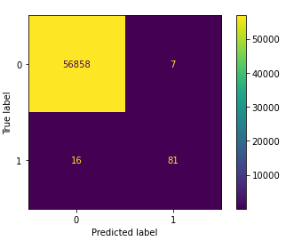
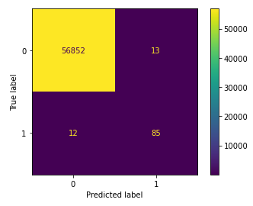
Comparing Confusion Matrix
Confusion matrix of Random Forest without balancing algorithm
Confusion matrix of Random Forest after balancing algorithm

Slide 40
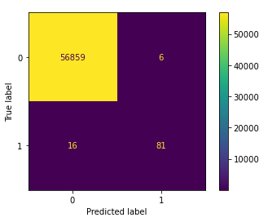
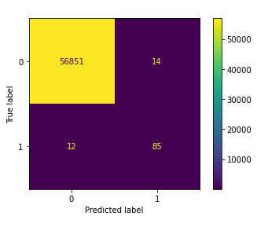
Comparing Confusion Matrix
Confusion matrix of XGBoost without balancing algorithm
Confusion matrix of XGBoost after balancing algorithm

Slide 41
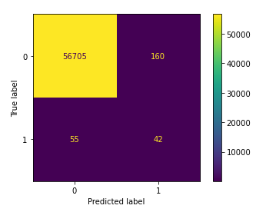
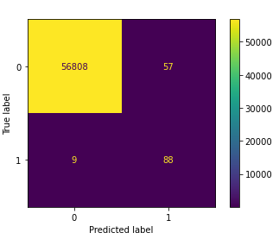
Comparing Confusion Matrix
Confusion matrix of LightGBM without balancing algorithm
Confusion matrix of LightGBM after balancing algorithm

Slide 42
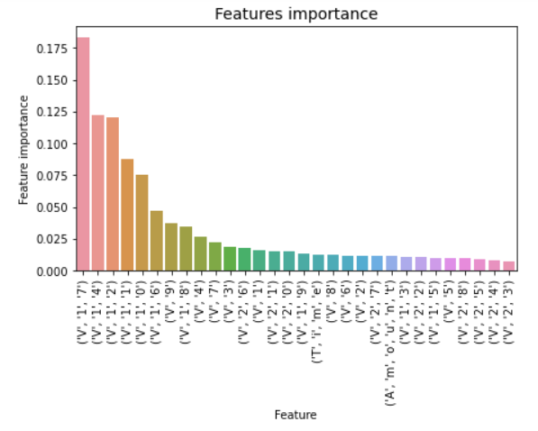
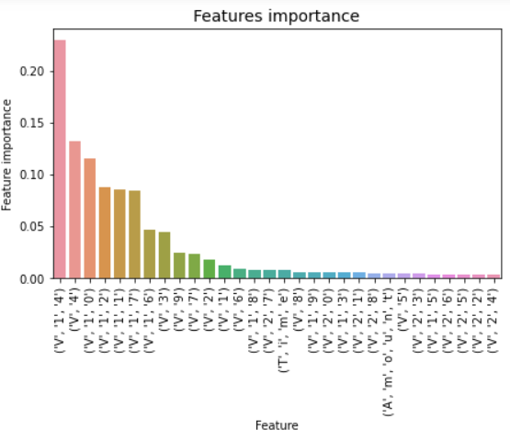
Comparing Features Importance
Random Forest without balancing algorithm
Random Forest after balancing algorithm

Slide 43
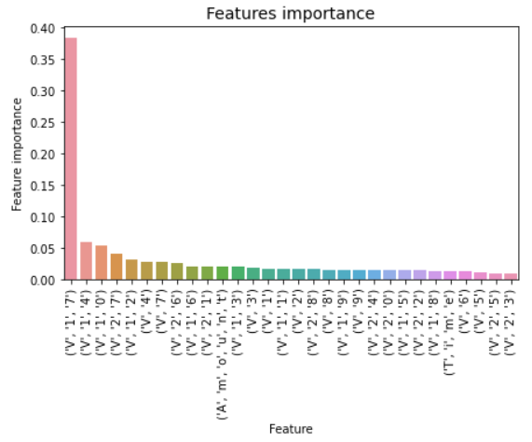
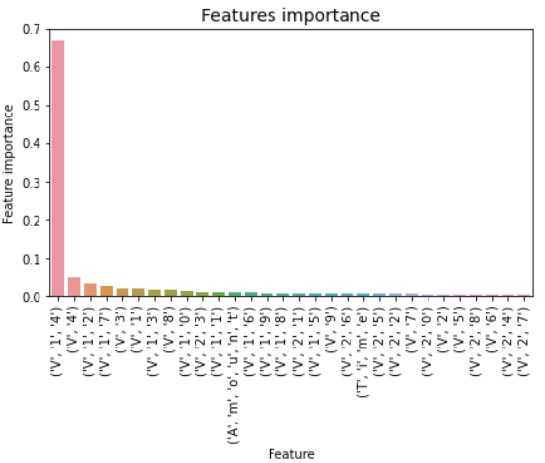
Comparing Features Importance
XGBoost without balancing algorithm
XGBoost after balancing algorithm

Slide 44
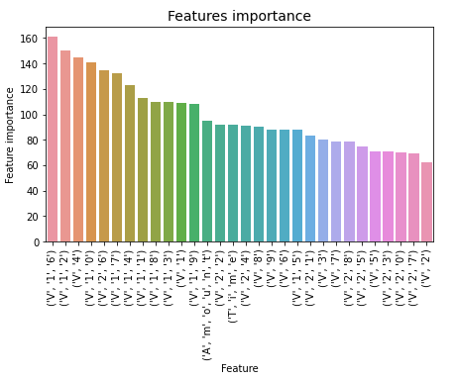
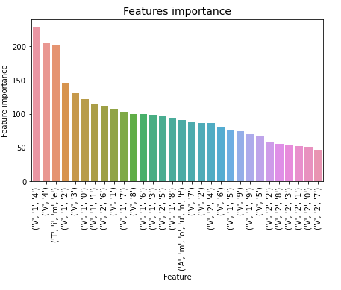
Comparing Features Importance
LightGBM without balancing algorithm
LightGBM after balancing algorithm

Slide 45
From graphs, we can see that ‘V17’ is dominant in cases of both Random Forest and XGBoost when no balancing algorithm is used. After applying balancing technique that is smote, ‘V14’ becomes more dominant in all three cases.

Slide 46
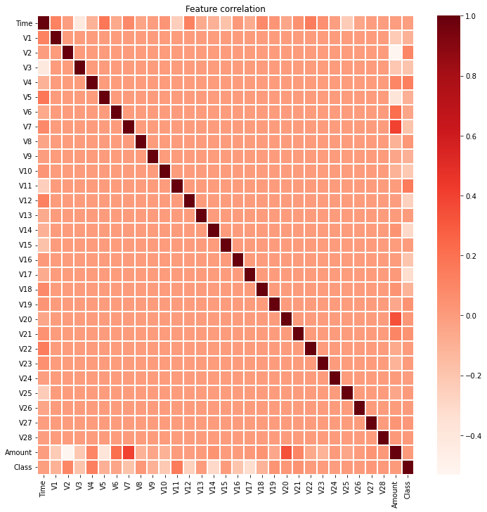
Features Correlation
The correlation have the following values:
In this particular example, 1 reflects a perfect positive correlation (between amount and V7, amount and V20.)
0 reflects no correlation (between features V1-V28)
-1 reflects perfect negative correlation (like between 'Time' and V3, then 'Amount' and V2, then between 'Amount' and V5).

Slide 47
Business Implications/Intelligence
The Nilson Report estimates that by 2020, there will be $30 billion in frauds committed against banks around the world.
The number of fraudulent transactions is also increasing with the emergence of various digital channels for payments, in addition to the rise in the number of digital payment gateways.
For fraud losses to be reduced, it is vital to develop effective fraud detection algorithms, which increasingly employ automated machine learning techniques as they assist fraud investigators in their investigations.

Slide 48
Business Implications/Intelligence
However, it is quite challenging to come up with fraud detection algorithms that are designed considering the non-stationary distribution of the data, the highly imbalanced distribution of the classes and the continuous stream of transactions.
In the meantime, public data are scarce due to government policy regarding confidentiality, thereby leaving a multitude of questions unanswered about the best way to approach this problem.

Slide 49
Business Implications/Intelligence
In order to make their fraud protection systems more effective, financial institutions have to make use of ML-powered systems that reduce substantially the risk of missing suspect transactions, the likelihood of human errors, and the incidence of security breaches.
Algorithms based on machine learning have the potential to handle enormous volumes of data in order to prevent fraud.
By using machine learning, companies not only save time and energy that would otherwise be used on traditional predictive analytics, but they also allow them to stay safe from fraud.

Slide 50
Conclusion
As the use of credit card fraud as a way to commit fraud is increasing at a frightening rate, credit card fraud detection is becoming an important topic of research.
The purpose of this paper is to present a robust framework that can be used to process large volumes of data, whereby the functionality of the framework may be extended in order to extract real time data from different distant source systems. It is then used to create a strong analytical model using the extracted data.

Slide 51
Conclusion
We have implemented three different analytical techniques in order to increase the analytical accuracy of fraud prediction. An evaluation of the effectiveness of these analytical models is done by running them on a credit card dataset by using various evaluation patterns and confusion matrix.
In the analysis conducted, 'V14' is found to be the most dominant feature in the case of smote balancing algorithms, it is found that 'V17' is the most dominant feature when no data balancing algorithms are employed in the case.

Slide 52
Future Work
In future, the performance of algorithms can be improved by using the techniques for tuning the hyperparameters like randomized searchCV and grid searchCV etc.
We can study more machine learning techniques including neural networks for building more efficient model. The balancing techniques including borderline-smote and hybrid approaches can be used to study the effects on evaluation metrics.

Slide 53
References
• Value of payment card fraud worldwide 2027 | Statista. (n.d.). Retrieved April 18, 2022, from https://www.statista.com/statistics/1264329/value-fraudulent-card-transactions-worldwide/
Alfaiz, N. S., & Fati, S. M. (2022). Enhanced Credit Card Fraud Detection Model Using Machine Learning. Electronics, 11(4), 662.
Credit Card Fraud Detection | Kaggle. (n.d.-a). Retrieved April 18, 2022, from https://www.kaggle.com/datasets/mlg-ulb/creditcardfraud
Credit Card Fraud Detection | Kaggle. (n.d.-b). Retrieved April 19, 2022, from https://www.kaggle.com/code/gauravduttakiit/credit-card-fraud-detection/notebook#Decision-Tree-on-balanced-data-with-ADASYN
Nicholson, C. (2019). Evaluation Metrics for Machine Learning - Accuracy, Precision, Recall, and F1 Defined | Pathmind. https://wiki.pathmind.com/accuracy-precision-recall-f1
Pranjalk. (2017). Light GBM vs XGBOOST: Which algorithm takes the crown. https://www.analyticsvidhya.com/blog/2017/06/which-algorithm-takes-the-crown-light-gbm-vs-xgboost/

Slide 54
References
Ramraj, S., Uzir, N., Sunil, R., & Banerjee, S. (2016). Experimenting XGBoost algorithm for prediction and classification of different datasets. International Journal of Control Theory and Applications, 9, 651–662.
Sruthi E R. (2021). Random Forest | Introduction to Random Forest Algorithm. https://www.analyticsvidhya.com/blog/2021/06/understanding-random-forest/
Sudeep Srivastava. (2022). How Machine Learning Helps in Financial Fraud Detection? https://appinventiv.com/blog/role-of-machine-learning-in-financial-fraud-detection/
SWASTIK SATPATHY. (2020). SMOTE | Overcoming Class Imbalance Problem Using SMOTE. https://www.analyticsvidhya.com/blog/2020/10/overcoming-class-imbalance-using-smote-techniques/
Tanouz, D., Subramanian, R. R., Eswar, D., Reddy, G. V. P., Kumar, A. R., & Praneeth, C. H. V. N. M. (2021). Credit card fraud detection using machine learning. 2021 5th International Conference on Intelligent Computing and Control Systems (ICICCS), 967–972.
Tiwari, P., Mehta, S., Sakhuja, N., Kumar, J., & Singh, A. K. (2021). Credit Card Fraud Detection using Machine Learning: A Study. ArXiv Preprint ArXiv:2108.10005.

Slide 55


